Slide 1
Topic 16 Integer Overflow and Proprietary Formats
ST251Z Ethical Hacking and Defences

Slide 2
Overflow of data
Buffer overflow attempts to store data larger than its allocated size in memory
Integer overflow is similar
Integer overflow occurs when a number is larger than that variable’s type can handle

Slide 3
Common Data Types
Boolean – 1 byte
Char – 1 byte
Short integer – usually 2 bytes
Integer – usually 4 bytes
Long – usually 8 bytes

Slide 4
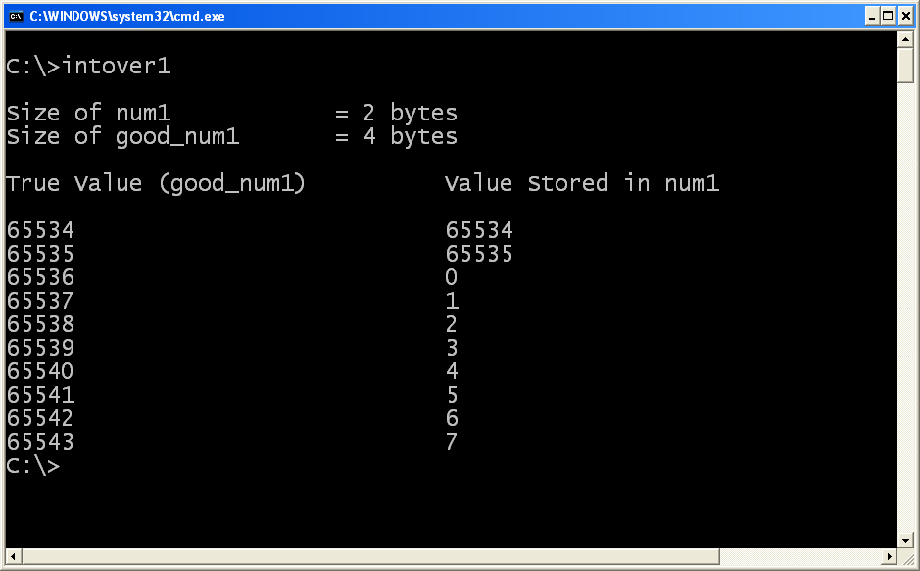
Overflow in unsigned int
When unsigned num1 reaches the maximum value, an increment of 1 will cause it to overflow

Slide 5
Two’s complement system
Allows representation of negative numbers
Eg. 2’s complement of 4 bit binary
1110
0001 <- flip (1’s complement)
+ 1
====
0010 <- decimal 2 !
Therefore 1110 = -2

Slide 6
Wraparound effects
Two's complement | Decimal
0111 | 7
0010 | 2
0001 | 1
0000 | 0
1111 | -1
1110 | -2
1000 | -8

Slide 7
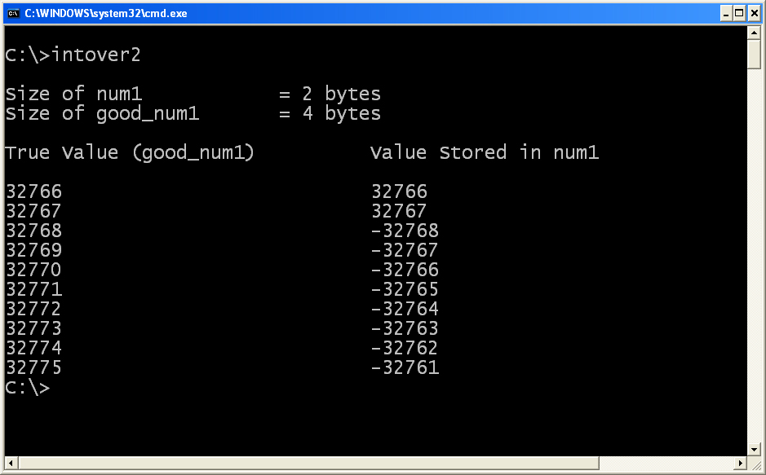
Wraparound effects
When num1 reaches the maximum positive value, an increment of 1 will cause it to overflow

Slide 8
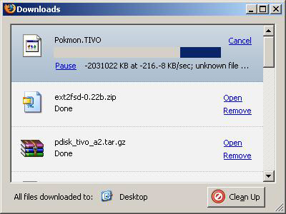
Effects of Integer Overflow
Integer overflow may happen when performing arithmetic operations
Firefox Web Browser:
Download a very very large file

Slide 9
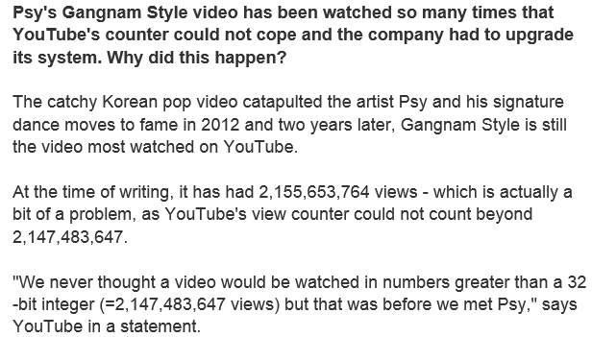
Gangam Style too much for Youtube counter
http://www.wired.com/2014/12/gangnam-style-youtube-math/

Slide 10
Exploiting Integer Overflow
No specific exploits
May be crashing of application (divide by zero)
May even be escalation of privileges
May be simply buying items on eCommerce site for negative price!

Slide 11
Finding Vulnerability
Integer overflow can be extremely tedious and difficult to find
Whitebox testing: easier to look for cast from larger type to smaller type
Blackbox testing: can also be challenging
Guess upper limit
Then + 1

Slide 12
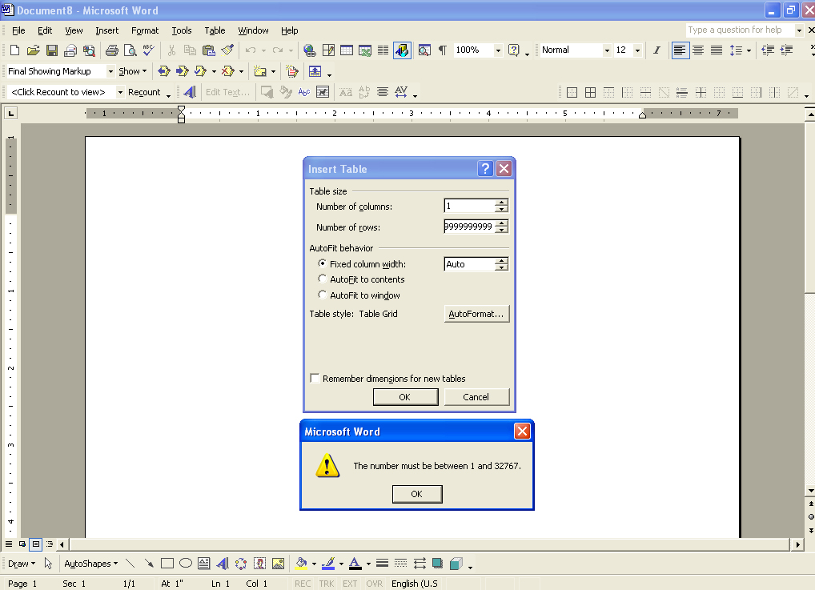
Eg. MS Words Table
Fill max row
Insert row
Words will hang!

Slide 13
Fixing the vulnerability
Always check the input range
Test data before storing
Some questions to consider:
Should there be any –ve values; if not, use unsigned int
When comparing 2 integers, are they of the same type?
When performing arithmetic operations, can the result be larger/smaller than the size?
Are sanity checks done before operation?
Are you making any trust assumptions (eg. Always zero, always +ve, etc)

Slide 14
Exercise 1 : Data type sizes
Create a C program to print out the sizes of various data types
For example, to print the size of an integer:
printf(“Size of int data type is %d bytes\n", sizeof(int));
Find the size of : short int, int, long int, float, double, char
Run on Linux and Windows platform to see if there is any difference in the data type sizes
You can refer to the Practical 16 document for step by step instructions

Slide 15
Exercise 2 : Two’s Complement
Create a C program with an integer that contains the maximum positive value
int num;
num = 0x7FFFFFFF;
Increment num by 1 and print out its value
What happens if you change the data type of num to “unsigned int”?

Slide 16
Proprietary Formats

Slide 17
Introduction
Users don’t usually interact with raw data (eg Word format, BMP format)
Applications will read raw data and display them in a human-readable mode
Microsoft Word will display a Word-formatted document with the margins, tables, bold font, etc.
Programmers of these applications need to follow the protocol or format of the raw data
Storing and retrieving is up to programmers

Slide 18
Introduction
Programmers may choose
Easier method of storing and retrieving data at the expense of readability
Close resemblance to in-memory data structure at the expense of protection from errors or malicious acts
Proprietary obscurity to prevent interoperability with competitor product

Slide 19
Types of file format
Some file formats may be open and can be reused by other applications
Other file formats might be proprietary
Some may be simple, others may be complex
A complex file format may not mean it is more secure

Slide 20
Security
The more a format/protocol is designed for obscurity, speed or ease of programming,
The less likely it will contain extensive error handling
Application crash
Expose buffer overflow
Permit unauthorised operations

Slide 21
Security
Proprietary protocols/formats
Programmers assume only their application can access and modify data following their proprietary protocols/formats
Programmers may trust the data in the files being read by their application
Attackers may create a corrupted file/data and cause the application to behave in unexpected ways

Slide 22
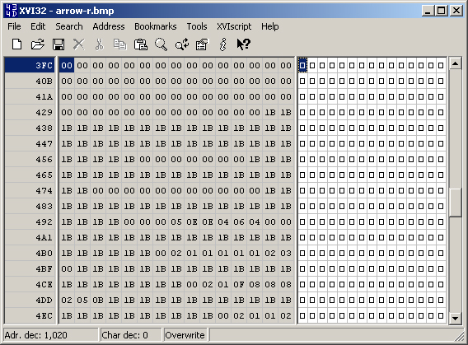
Example: Image Formats
BMP files are just color codes

Slide 23
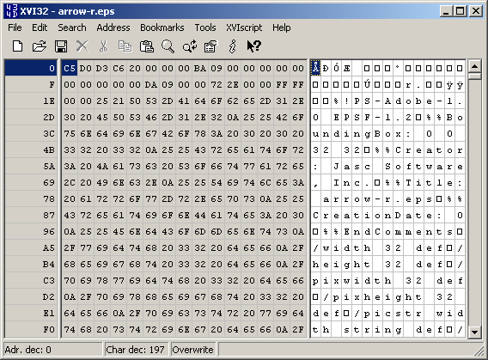
Example: Image Formats
Encapsulated PostScript may contain codes

Slide 24
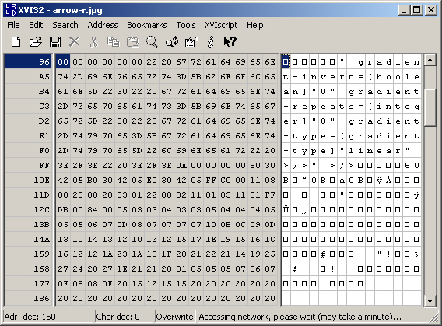
Example: Image Formats
JPEG contains mixed text and binary data

Slide 25
Example: Image Formats
BMP: corruption of data at most causes bad pixel in image
EPS: attacker may insert malicious codes (infinite loops until the computer runs out of memory => DoS)
JPEG: text may be interpreted as data or vice versa. => DoS, buffer overflow

Slide 26

Example: Microsoft’s Clipart
Clipart Gallery file format (CIL) vulnerability, ie. Security Bulletin MS00-015
Sting that contained destination of filename is not properly checked for legitimate length
Result in crash and execute arbitary code supplied by attacker.

Slide 27
Tools and Techniques
Need automated tools to help discover vulnerability that may lead to:
Crash,
Hang,
Buffer overflow
Fuzzing – technique of randomising input data to test the robustness of the software application

Slide 28
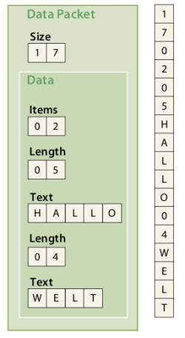
Fuzzing
Examples
Substitute data with random garbage
Insert very long string
Create out-of-order messages/packets

Slide 29
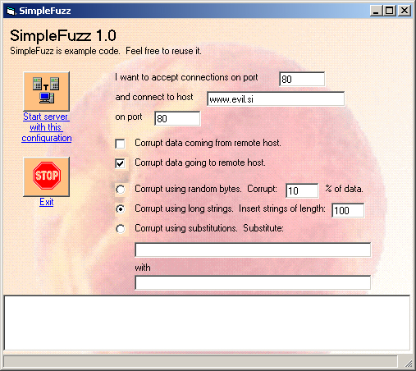

Slide 30
Preventing problems
Do not trust all inputs
Use a format for which a bug-free parsers/tools already exists, eg. XML
Don’t rely on length fields or delimiters in protocols/data. Check actual length of data
Never use signed integer when decoding length (to prevent integer overflow in case an extremely long piece of data is encountered)

Slide 31
Summary
Integer overflow – a type of buffer overflow when a value that is too large (or too small) is stored in the number variable
Software applications may use open or proprietary protocols/formats
Must always check all input data

